Slide 1
Arithmetic Logical Unit
Kukarcev KS, 4167

Slide 2
What is it?
ALU (arithmetic unit block) – a fundamental building block of many computer curcuits.
CPU, FPU, GPU.
carries out arithmetic and logic operations on the operands in computer instruction words.
Was proposed by John von Neumann in 1945

Slide 3
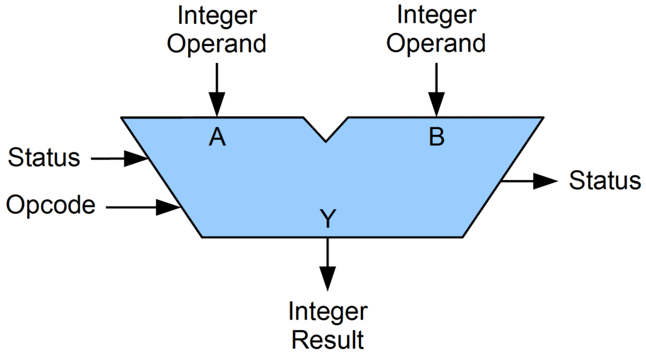

Slide 4
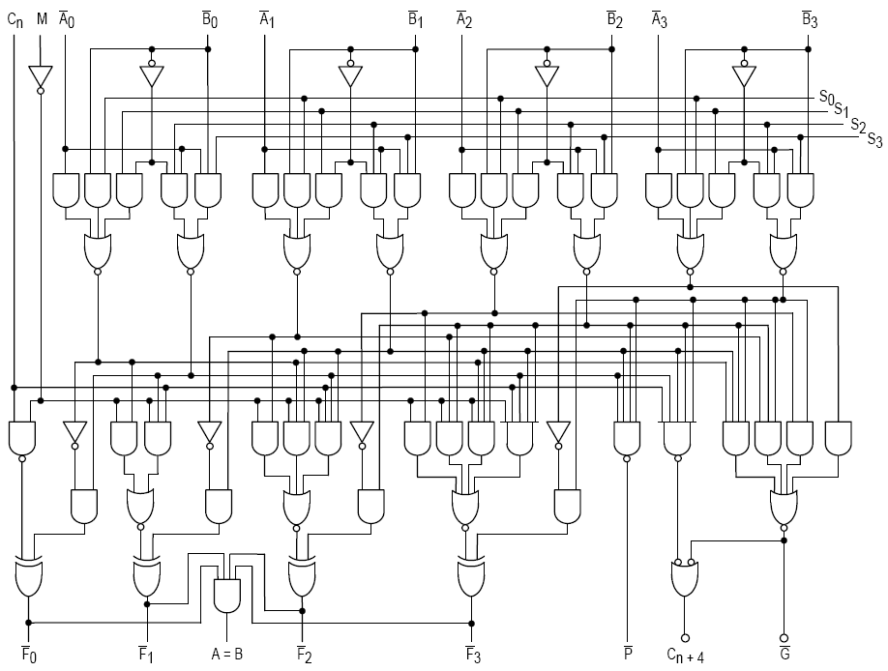
4-bit ALU by Texas Instruments

Slide 5
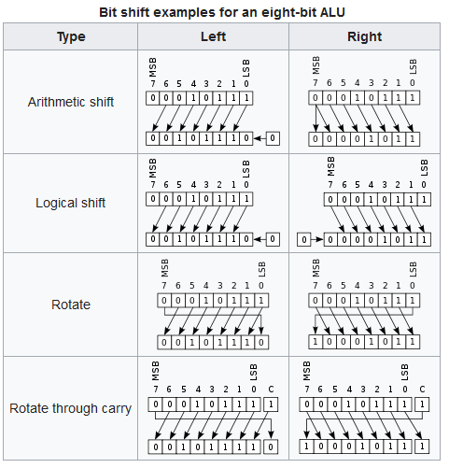
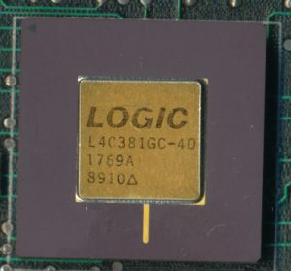
Logic L4C381GC-40

Slide 6
Routines
Logical Operations: AND, OR, NOT, XOR, NOR, NAND, etc.
Bit-Shifting Operations
Arithmetic Operations: +, -.
Multiplication and division are implemented by “+” and “–” respectevly,

Slide 7
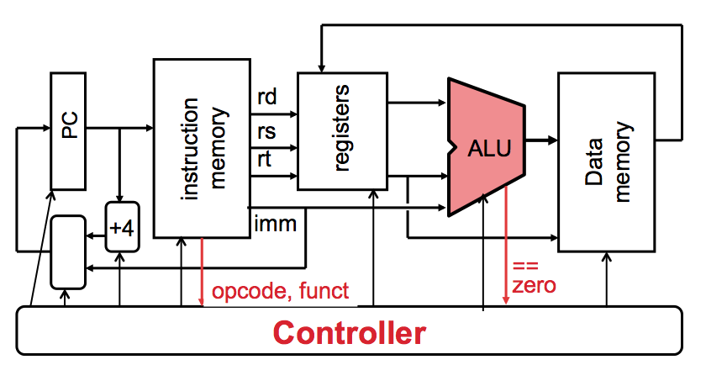
Application
Multiple-precision arithmetic
Complex operations

Slide 8
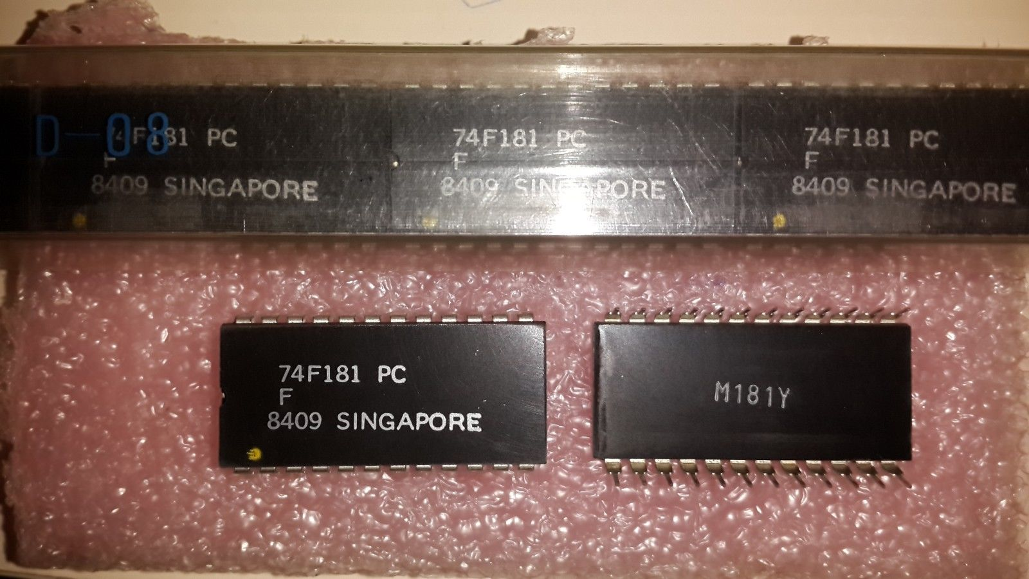
Summary
ALU can perform many function
ALU chips can be combined together to form larger ALU chips
ALU’s form the basis of datapaths
Connected to RAM as control paths

Slide 9
Thanks for your attention

